Slide 1


Francisco Ricardo Andraschko
Feb 2025

Slide 2

Outline
Executive Summary
Introduction
Methodology
Results
Conclusion

Slide 3
Executive Summary
Summary of methodologies
Data collection
Data wrangling
Exploratory Data Analysis (EDA) with Data Visualization
Exploratory Data Analysis (EDA) with SQL
Building an interactive map with Folium
Building a Dashboard with Plotly Dash
Predictive analysis (Classification)
Summary of all results
Exploratory Data Analysis results
Interactive analytics demo in screenshots
Predictive analysis results

Slide 4
Introduction
Project background and context
SpaceX has emerged as a pioneering leader in the modern commercial space era by making space travel significantly more affordable. With Falcon 9 launches priced at around 62 million dollars —compared to over 165 million dollars for competitors—the company’s ability to reuse the first stage is a game changer. This reusability not only drives down costs but also provides a competitive edge in the aerospace market.
This project leverages public data and machine learning models to predict whether the Falcon 9 first stage will successfully land. By accurately forecasting landing outcomes, we can better estimate launch costs and gain insights into the factors influencing a safe recovery.
Problems you want to find answers
What are the main characteristics that distinguish successful from failed landings?
How do variables like payload mass, launch site, number of flights, and orbital conditions affect landing success?
Has the success rate of first stage landings improved over the years?
What is the most effective binary classification algorithm for predicting first stage reuse?

Slide 5

Section 1

Slide 6
Methodology
Data collection methodology
Utilized SpaceX REST API and web scraping from Wikipedia.
Data wrangling
Filtered the data, dropped unnecessary columns, and handled missing values.
Data Preparation
Applied One Hot Encoding for binary classification.
Exploratory Data Analysis (EDA)
Performed analysis using visualization techniques and SQL.
Interactive Visual Analytics
Employed Folium and Plotly Dash for interactive visualizations.
Predictive Analysis
Built, tuned, and evaluated classification models to ensure optimal results.

Slide 7
Data Collection
Our data collection process integrated two complementary approaches to build a comprehensive dataset for analysis:
SpaceX REST API: We accessed the SpaceX REST API (api.spacexdata.com/v4/) to retrieve a JSON file containing detailed launch information (e.g., flight numbers, dates, booster versions, payload mass, etc.). The JSON data was then transformed into a dataframe, cleaned, and exported.
Wikipedia Web Scraping: We scraped the Falcon 9 and Falcon Heavy launches page on Wikipedia to extract additional launch details (e.g., launch site, payload, customer, launch outcome, etc.). The HTML content was processed using BeautifulSoup, converted into a dataframe, and exported.

Slide 8
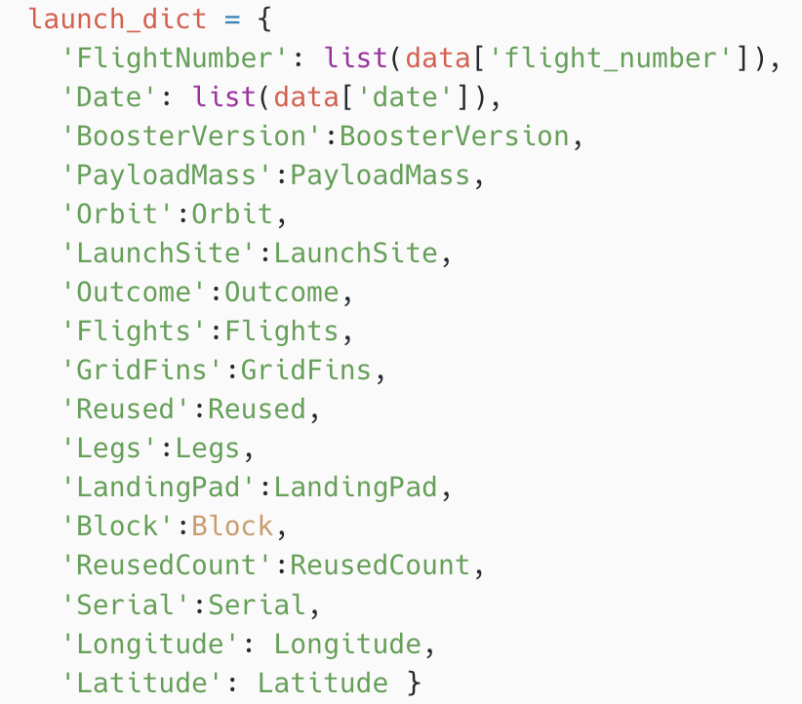
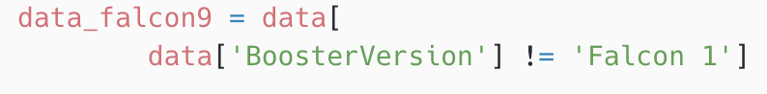
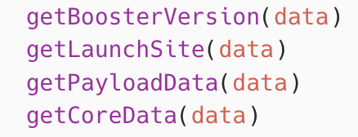
Data Collection – SpaceX API
1. API Call
5. Create Dataframe
4. Create Dictionary
2. Receive JSON File
6. Filter Dataframe
3. Transform Data
7. Export CSV
GitHub URL -> Data Collection API

Slide 9
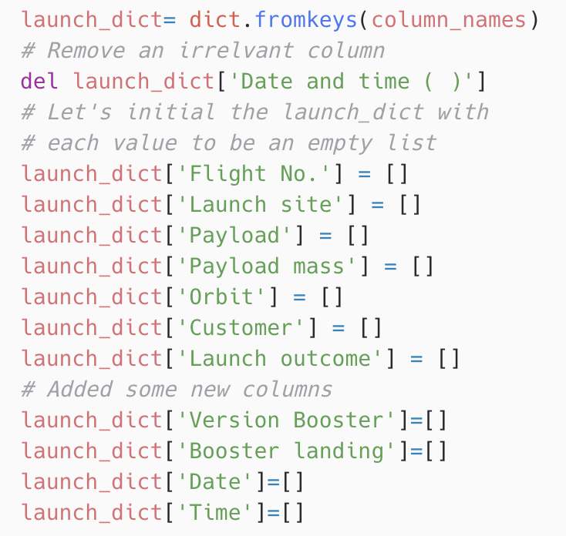
Data Collection - Scraping
1. Access URL
4. Create Dictionary
2. Retrieve HTML Response
3. Transform Data
6. Export CSV
5. Create Dataframe
GitHub URL -> Data Collection Web Scraping

Slide 10
Data Wrangling
Our data processing involved transforming raw landing outcome strings into a binary format and performing exploratory analysis. We handled cases where the booster landing outcome was recorded as strings such as "True Ocean," "True RTLS," and "True ASDS" (indicating success) and their corresponding false values (indicating failure). These outcomes were converted into categorical training labels where “1” signifies a successful landing and “0” a failure.
Additionally, we performed exploratory data analysis (EDA) by:
Calculating the number of launches at each site
Counting occurrences of each orbit type
Analyzing mission outcomes by orbit
Creating a new landing outcome label from the Outcome column
Exporting the processed data to CSV
GitHub URL -> Data Wrangling

Slide 11
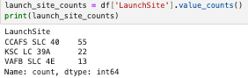
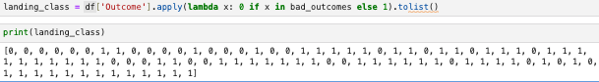
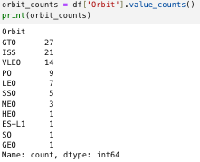
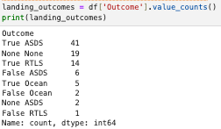
Data Wrangling
1. Calculating the number of launches at each site
4. Creating a new landing outcome label from the Outcome column
11
2. Counting occurrences of each orbit type
3. Analyzing mission outcomes by orbit
5. Export CSV
GitHub URL -> Data Wrangling

Slide 12



EDA with Data Visualization
• Flight Number vs. Payload Mass • Flight Number vs. Launch Site • Payload vs. Launch Site • Orbit vs. Flight Number • Payload vs. Orbit Type • Orbit vs. Payload Mass
Scatter plots reveal relationships (correlations) between numerical variables, helping to understand how factors like flight number, payload mass, launch site, and orbit type interact.
Line graphs track trends over time, providing insight into how the success rate evolves year by year, which is useful for predicting future performance.
• Success Rate vs. Year
Bar graphs compare numerical data against categorical variables (e.g., orbit types) to highlight differences in success rates.
• Success Rate vs. Orbit
GitHub URL -> EDA with Data Visualization

Slide 13
EDA with SQL
The SQL queries performed were:
• Retrieved a distinct list of launch sites from the mission dataset. • Selected five records where the launch site names begin with 'CCA'. • Summed the payload mass carried by boosters launched by NASA (CRS). • Calculated the average payload mass for booster version F9 v1.1. • Determined the earliest date of a successful ground pad landing. • Listed booster versions that achieved successful drone ship landings with payload masses between 4000 and 6000. • Counted the total number of successful versus unsuccessful mission outcomes. • Identified the booster versions that carried the maximum payload mass using a subquery. • Extracted records for 2015 showing failed drone ship landings, along with corresponding booster versions and launch sites. • Ranked landing outcome counts (e.g., Failure (drone ship), Success (ground pad)) between 2010-06-04 and 2017-03-20 in descending order.
GitHub URL -> EDA with SQL

Slide 14
Build an Interactive Map with Folium
Integrating diverse mapping elements, our interactive Folium map offers a comprehensive view of launch site distribution, performance outcomes, and geographical context—all within one dynamic map.
Markers & Circles:
Placed at each launch site (with labels/popups) to clearly identify locations.
Marker Clusters:
Grouped nearby markers to reduce clutter in dense areas.
Colored Icons:
Used green for successes and red for failures to quickly convey landing outcomes.
Lines:
Connected launch sites to nearby landmarks (e.g., railways, highways, cities) to show spatial relationships.
GitHub URL -> Interactive Map w/ Folium

Slide 15
Build a Dashboard with Plotly Dash
An interactive dashboard was created to dynamically explore and analyze launch data:
Launch Sites Dropdown:
Provides selection of a specific launch site or all sites (using dash_core_components.Dropdown).
Success Launches Pie Chart:
Displays overall success counts and a breakdown of success versus failure for the chosen launch site (using plotly.express.pie).
Payload Mass Range Slider:
Allows filtering of data based on a specified payload mass range (using dash_core_components.RangeSlider).
Payload Mass vs. Success Rate Scatter Chart:
Visualizes the correlation between payload mass and launch success across different booster versions (using plotly.express.scatter).
GitHub URL -> Ploty Dash

Slide 16
Predictive Analysis (Classification)
Creating a NumPy array from the "Class" column
Standardizing the data with StandardScaler
Splitting the data into training and testing sets
Configuring GridSearchCV with 10-fold cross-validation
Training models (LogReg, SVM, Decision Tree, KNN) using GridSearchCV
Calculating test accuracy with .score()
Examining confusion matrices
Comparing models using Jaccard and F1 scores
GitHub URL -> Machine Learning Prediction

Slide 17
Results
Exploratory data analysis results
Interactive analytics demo in screenshots
Predictive analysis results

Slide 18

Section 2

Slide 19
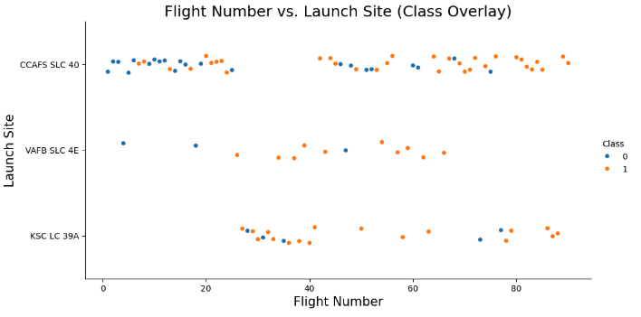
Flight Number
vs.
Launch Site
This plot shows flight numbers against launch sites. Early flights generally failed, while later flights succeeded more often. Also, CCAFS SLC 40 is the most frequently used launch site.

Slide 20
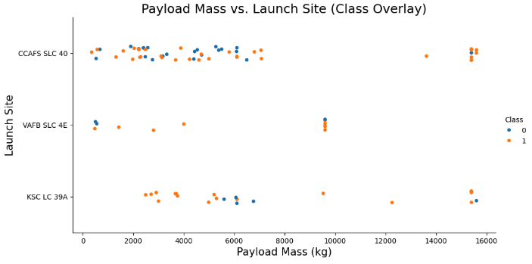
Payload
vs.
Launch Site
This chart displays payload mass for each launch site. Higher payloads tend to correlate with increased success, and sites like KSC LC 39A show strong performance even with lighter payloads.

Slide 21
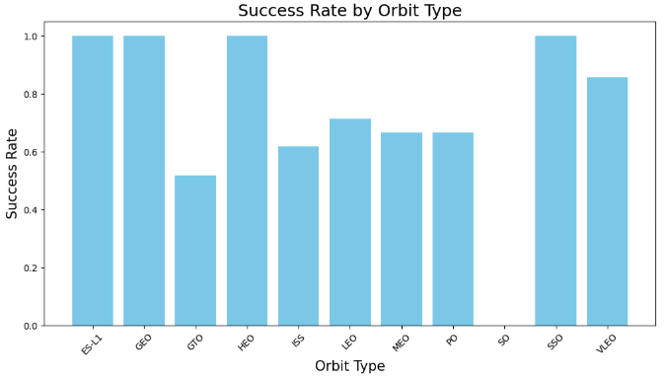
Success Rate
vs.
Orbit Type
Here, average success rates are compared across orbit types. Orbits such as ES-L1, GEO, HEO, and SSO reach 100% success, while SO shows very low performance. Other orbits fall between 50% and 85%.

Slide 22
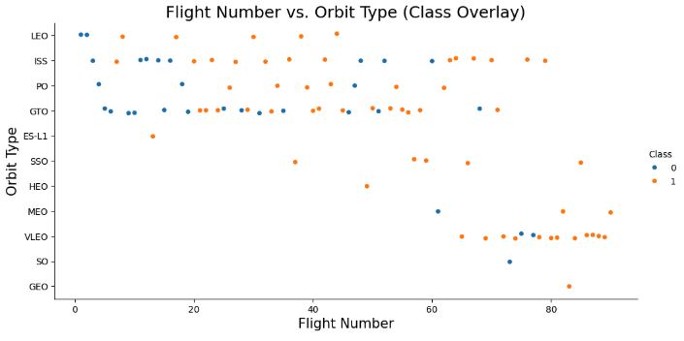
Flight Number
vs.
Orbit Type
This scatter plot examines flight numbers in relation to orbit types. In LEO, success appears to improve with more flights, but no clear trend is observed for orbits like GTO.

Slide 23
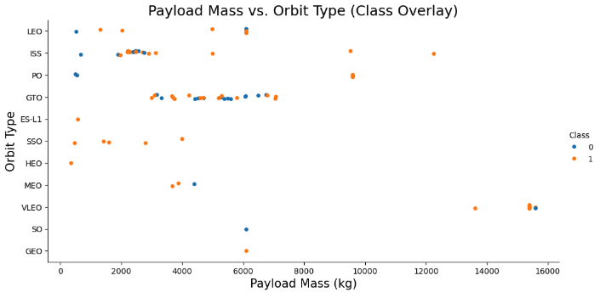
Payload
vs.
Orbit Type
This visualization relates payload mass to orbit type. It indicates that heavy payloads negatively impact GTO success, while they favor better outcomes in Polar and LEO (ISS) orbits.

Slide 24
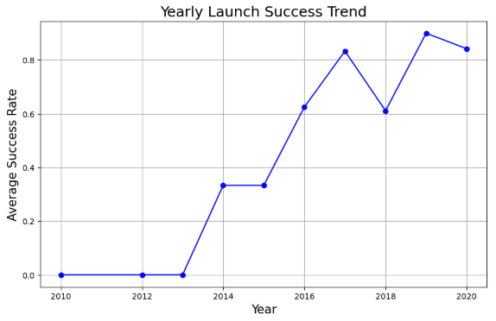
Launch Success Yearly Trend
This line chart tracks the annual average success rate, showing a steady increase from 2013 up to 2020.

Slide 25
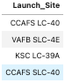
All Launch Site Names
SQL Query
Results
Explanation:
This query extracts distinct launch site names from the dataset, providing a complete list of all locations where launches occurred.

Slide 26
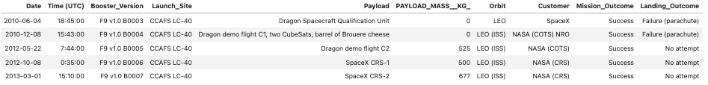
Launch Site Names Begin with 'CCA'
SQL Query
Results
Explanation:
Displays 5 records where launch site names start with 'CCA'. This helps verify data consistency for sites like CCAFS SLC-40.

Slide 27
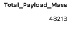
Total Payload Mass
SQL Query
Results
Explanation:
Calculates the sum of payload masses for boosters operated by NASA (CRS), offering an aggregate measure of payload capacity for these missions.

Slide 28
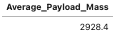
Average Payload Mass by F9 v1.1
SQL Query
Results
Explanation:
Computes the average payload mass for launches using booster version F9 v1.1, providing insight into typical payload sizes for this version.

Slide 29
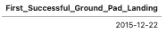
First Successful Ground Landing Date
SQL Query
Results
Explanation:
Uses the MIN function to identify the earliest date of a successful ground pad landing, marking a key operational milestone.

Slide 30
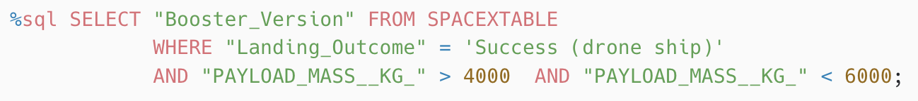
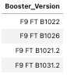
Successful Drone Ship Landing with Payload between 4000 and 6000
SQL Query
Results
Explanation:
Lists booster versions that achieved successful drone ship landings with payload masses between 4000 and 6000, highlighting specific performance cases.

Slide 31
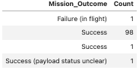
Total Number of Successful and Failure Mission Outcomes
SQL Query
Results
Explanation:
Groups and counts mission outcomes to show the overall numbers of successes versus failures across all missions.

Slide 32
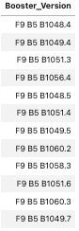
Boosters Carried Maximum Payload
SQL Query
Results
Explanation:
Identifies the booster versions that carried the maximum payload mass using a subquery, pinpointing record-holders in payload capacity.

Slide 33
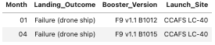
2015 Launch Records
SQL Query
Results
Explanation:
Extracts records for 2015 detailing failed drone ship landings, including booster versions and launch site names, to uncover patterns in these failures.

Slide 34
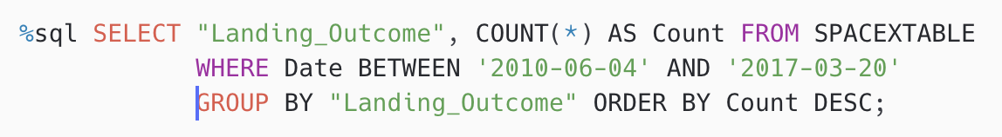
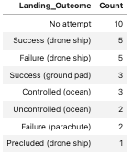
Rank Landing Outcomes Between 2010-06-04 and 2017-03-20
SQL Query
Results
Explanation:
Ranks landing outcomes by their frequency within the specified date range, highlighting the most common outcomes in descending order.

Slide 35

Section 3

Slide 36
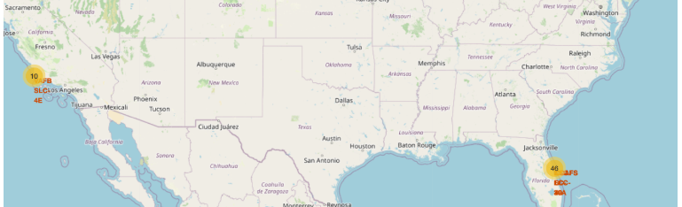
Global Map of Launch Sites
This global map displays all launch sites using markers and circles with labels and popups. Marker clusters help reduce clutter in dense regions, making it easy to identify the geographic distribution of launch sites.

Slide 37
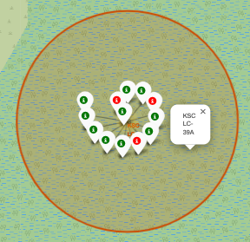
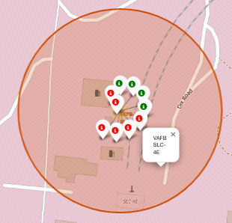
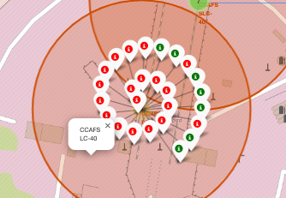
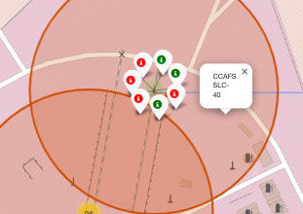
Colored Markers of Launch Outcomes
This view uses colored markers to represent launch outcomes—green for successful landings and red for failures. This visual differentiation allows quick assessment of performance across different sites. Notably, the following sites show higher occurrences:
CCAFS SLC-40: Exhibits the highest number of launches, with a mix of outcomes.
VAFB SLC-4E: Displays significant activity with a strong success rate.
KSC LC-39A: Also shows high launch frequency and excellent success performance.

Slide 38
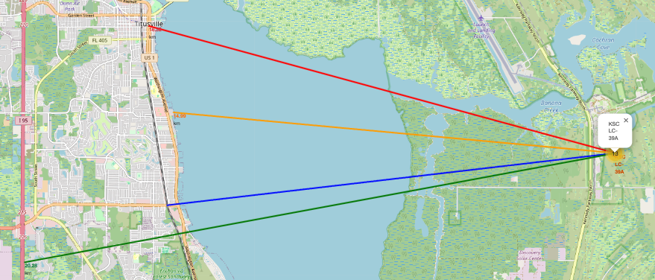
Proximity Analysis of a Selected Launch Site
From the visual analysis of launch site KSC LC-39A, the following distances were observed:
Railway: 15.23 km
Highway: 20.28 km
Coastline: 14.99 km
Nearest city (Titusville): 16.32 km
Given that a failed rocket can cover 15-20 km in a few seconds, these proximities highlight a potential risk to populated areas.

Slide 39

Section 4

Slide 40
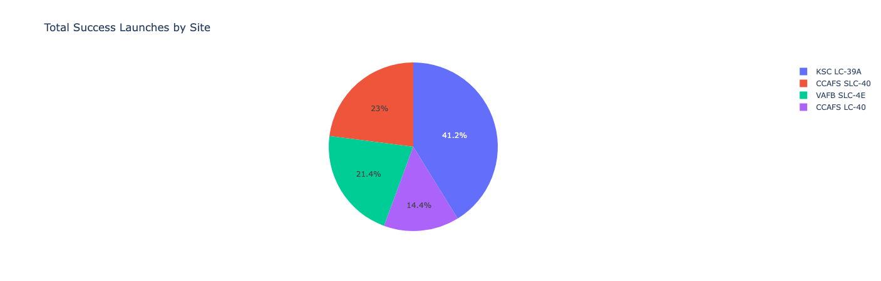
Dashboard – Overall Launch Success
Displays the total number of successful launches across all sites, highlighting which sites contribute most to the overall success count.

Slide 41
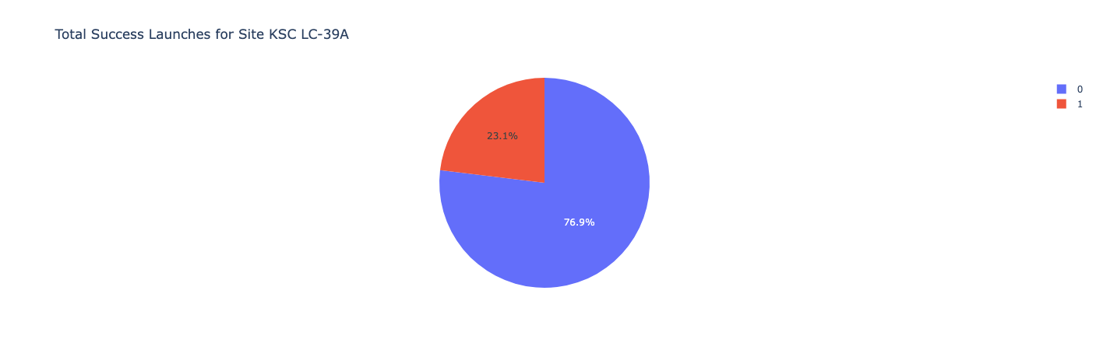
Dashboard – Top Site Success Ratio
Focuses on KSC LC-39A, the site with the highest success rate, showing the breakdown of successes (76.9%) vs. failures (23.1%).
Notes:
(

Slide 42
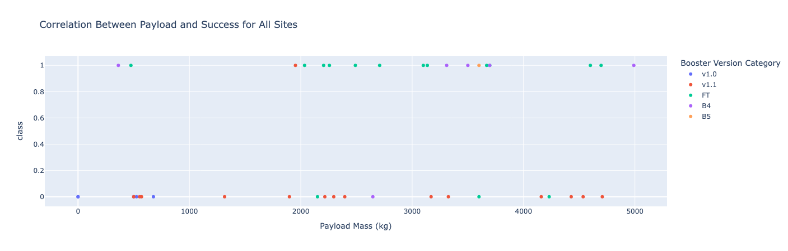
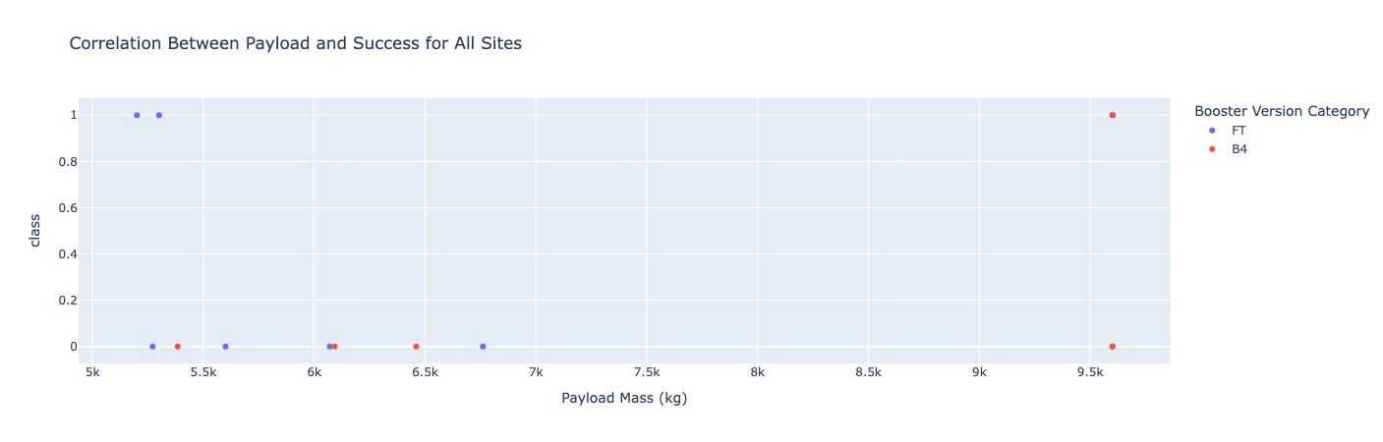
Dashboard – Payload vs. Launch Outcome
Low weighted payload (0 – 5000 kg)
For payloads from 0 to 5000 kg, the success rate is high and consistent. In contrast, the 5000 to 10000 kg range shows greater variability, indicating heavier payloads pose more challenges for successful landings.
Heavy weighted payload (5000 – 10000 kg)

Slide 43

Section 5

Slide 44
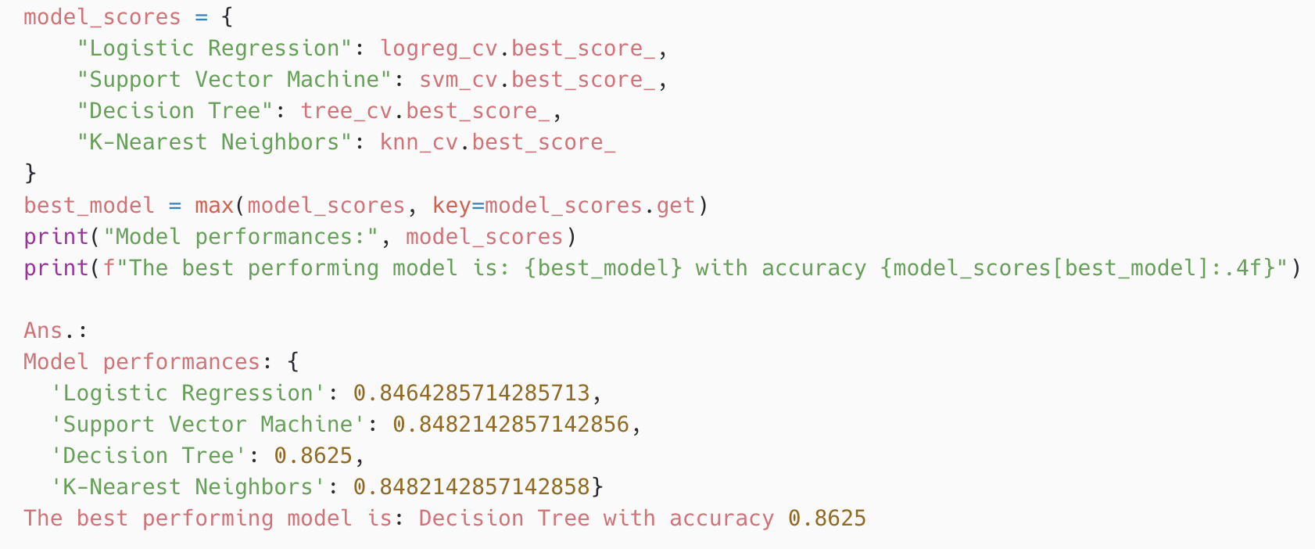
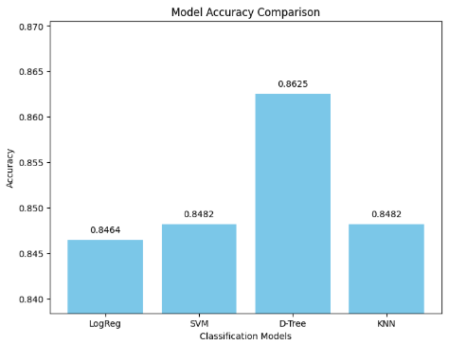
Classification Accuracy
This bar chart compares the accuracy of the four classification models. The Decision Tree model achieved the highest accuracy at 86.25%, suggesting it is the best performer for predicting Falcon 9 first stage landing outcomes.

Slide 45
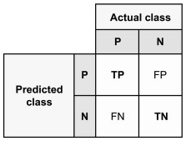
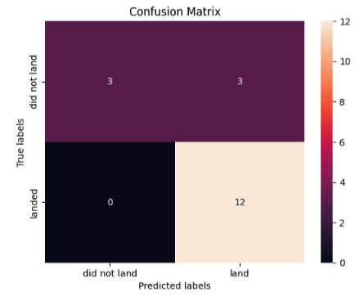
Confusion Matrix
The confusion matrix for the Decision Tree model shows high true positive and true negative counts, with very few false positives and false negatives. This indicates robust performance and reliable prediction of landing outcomes.

Slide 46
Conclusions
The Decision Tree model outperformed other classifiers, showing the highest accuracy and strong predictive performance.
Launches with lower payload masses (especially between 2000–5000 kg) tend to be more successful, while heavier payloads (5000–10000 kg) exhibit greater variability in outcomes.
Most launch sites are strategically located near the Equator and the coast, with KSC LC-39A demonstrating the highest success rate.
Certain orbits (ES-L1, GEO, HEO, SSO) consistently achieve 100% success, highlighting the importance of orbital selection.
An overall trend of increasing success over the years suggests that accumulated operational experience significantly contributes to better outcomes.

Slide 47


